Slide 1
Hurtownie Danych
Wprowadzenie do SSIS

Slide 2
Visual Studio

Slide 3
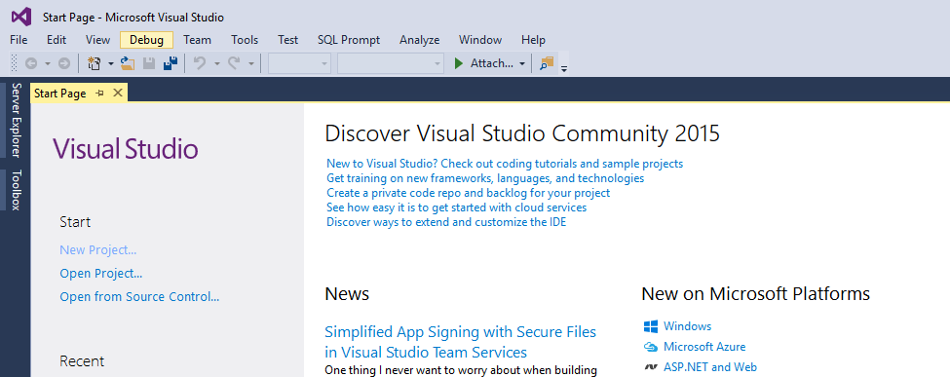
Visual Studio

Slide 4
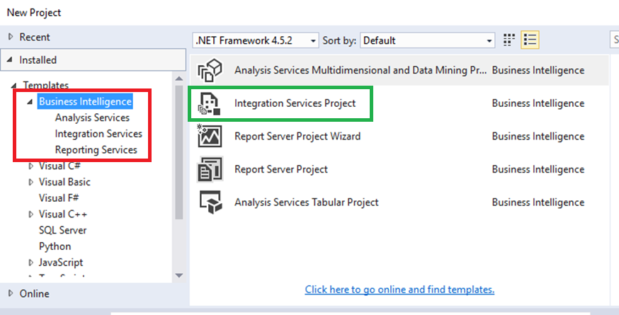
Visual Studio – SSDT BI

Slide 5
Integration Services Project

Slide 6
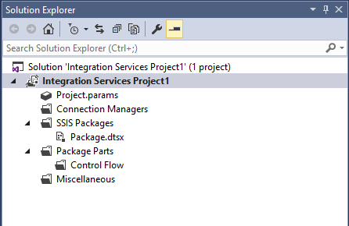
Integration Services
Solution
Project
Connecion Managers
Packages

Slide 7
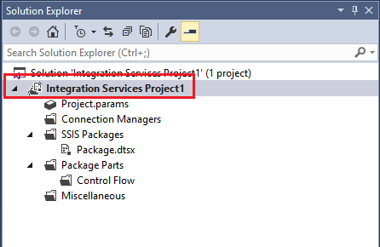
Integration Services - Poject
When you create an app, application, website, Web App, script, plug-in, etc in Visual Studio, you start with a project. In a logical sense, a project contains of all the source code files, icons, images, data files and anything else that will be compiled into an executable program or web site, or else is needed in order to perform the compilation.

Slide 8
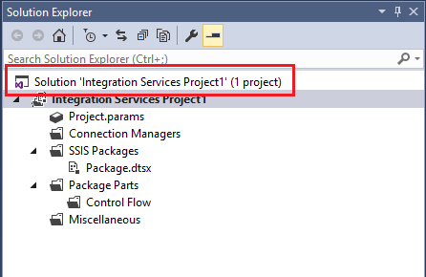
Integration Services - Solution
A project is contained, in a logical sense and in the file system, within a solution, which may contain one or more projects, along with build information, Visual Studio window settings, and any miscellaneous files that aren't associated with any project.

Slide 9
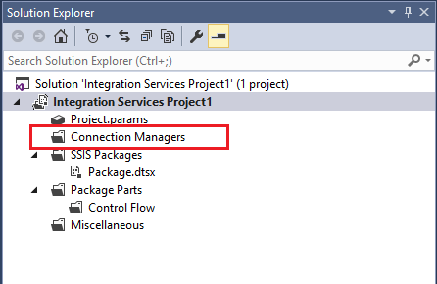
Integration Services – Connection Managers
Integration Services uses the connection manager as a logical representation of a connection. At design time, you set the properties of a connection manager to describe the physical connection that Integration Services creates when the package runs. For example, a connection manager includes the ConnectionString property that you set at design time; at run time, a physical connection is created using the value in the connection string property.

Slide 10
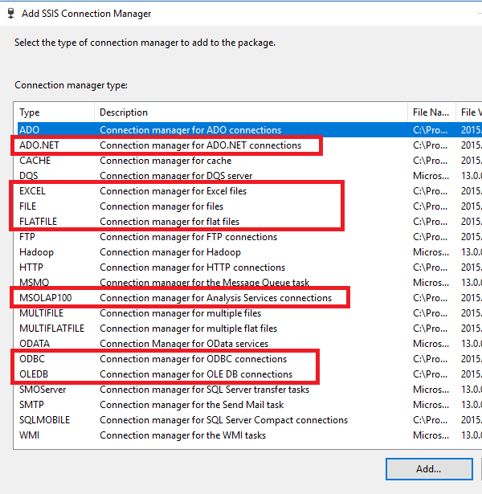
Connection Manager
ADO.NET
EXCEL
FILE
FLATFILE
MSOLAP100 (Analysis Services)
ODBC
OLEDB

Slide 11
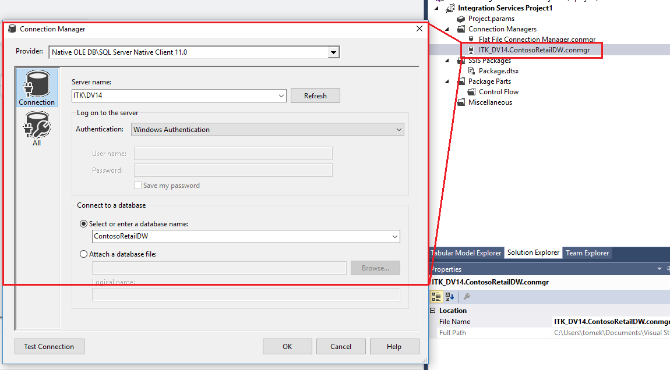
Connection Manager
Connection managers (connections). A package typically includes at least one connection manager. A connection manager is a link between a package and a data source that defines the connection string for accessing the data that the tasks, transformations, and event handlers in the package use.
Integration Services includes connection types for data sources such as text and XML files, relational databases, and Analysis Services databases and projects.

Slide 12
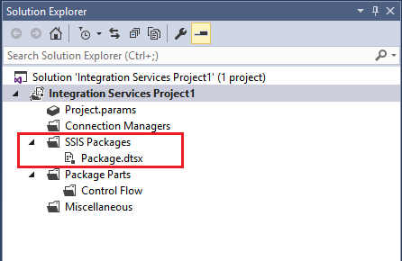
Integration Services – Packages
A package is an organized collection of connections, control flow elements, data flow elements, event handlers, variables, parameters, and configurations, that you assemble using either the graphical design tools that SQL Server Integration Services provides, or build programmatically.
The package is the unit of work that is retrieved, executed, and saved.
When you first create a package, it is an empty object that does nothing. To add functionality to a package, you add a control flow and, optionally, one or more data flows to the package.

Slide 13
Package

Slide 14
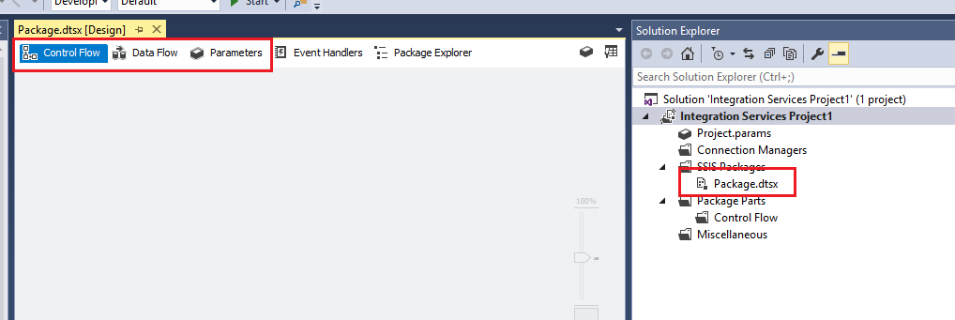
Package

Slide 15
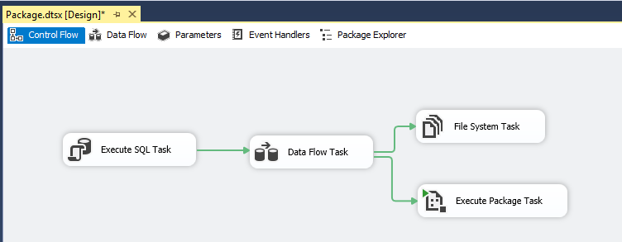
Controll Flow
A control flow consists of one or more tasks and containers that execute when the package runs. To control order or define the conditions for running the next task or container in the package control flow, you use precedence constraints to connect the tasks and containers in a package. A subset of tasks and containers can also be grouped and run repeatedly as a unit within the package control flow.
https://docs.microsoft.com/en-us/sql/integration-services/control-flow/control-flow

Slide 16
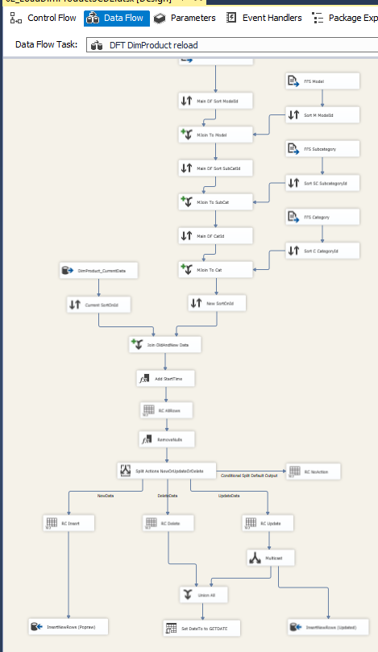
Data Flow
Data sources and destinations (data flow). A data flow consists of the sources and destinations that extract and load data, the transformations that modify and extend data, and the paths that link sources, transformations, and destinations. Before you can add a data flow to a package, the package control flow must include a Data Flow task.
The Data Flow task is the executable within the SSIS package that creates, orders, and runs the data flow. A separate instance of the data flow engine is opened for each Data Flow task in a package.

Slide 17
Hello World!

Slide 18
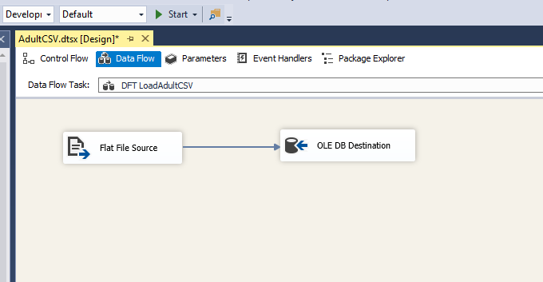
Load Data from CSV To DB

